Slide 1



Introduction to Women Empowerment
Women empowerment is the process of creating an environment where women can make effective decisions and take control over their lives.
by Mohini Bhardwaj

Slide 2
Importance of Women Empowerment in Society
Equal Opportunities
Social Development
Women empowerment ensures that women have the same opportunities as men in education, career, and leadership.
Empowering women leads to the overall development of society by leveraging the talents and abilities of half the population.
Reduced Poverty
Healthy Communities
When women are empowered, it contributes to poverty reduction by enabling them to earn independently and support their families.
Empowered women have a positive impact on the health and well-being of their families and communities.

Slide 3
Challenges Faced by Women
Gender Pay Gap
Lack of Leadership Opportunities
Work-Life Balance
Women often earn less than men for the same work, impacting financial stability.
Women often struggle to juggle professional responsibilities with family duties.
Women face barriers to advancing into leadership roles in various fields.
This gap widens for women of color, leading to economic disparities.
Unconscious bias and stereotypes can hinder career progression.
Challenges in accessing affordable childcare and support affect career growth.

Slide 4
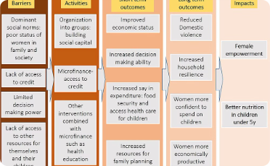


Examples of successful women empowerment initiatives
Microfinance Programs
Girls' Education Programs
Leadership Development Workshops
Initiatives providing financial support and entrepreneurship training to women in developing countries, leading to economic independence and community development.
Efforts focused on promoting access to quality education for girls, enabling them to acquire knowledge and skills for a brighter future.
Programs that equip women with leadership skills, promoting their participation across sectors and creating role models for future generations.

Slide 5

Benefits of Women Empowerment for Individuals and Communities
Increased Economic Opportunities: Empowered women contribute to household income and economic growth.
Empowerment of Future Generations: Empowered women raise empowered children, creating a positive cycle.
Community Development: Women empowerment leads to stronger, more resilient communities.

Slide 6

Strategies for promoting women empowerment
1
Educational Initiatives
Implement programs to ensure equal access to education for women and girls.
2
Economic Empowerment
Support entrepreneurship, microfinance, and job training programs for women.
3
Legal Reforms
Advocate for legal changes to ensure gender equality and protection of women's rights.

Slide 7
Role of Education in Empowering Women
Access to Opportunities
Empowerment for Decision-Making
Education opens doors to better job prospects, leadership roles, and economic independence for women.
Education equips women with the knowledge and confidence to make informed choices about their lives.
Health and Well-being
Social and Political Participation
Educated women are more likely to make healthy choices for themselves and their families.
Education encourages women to actively engage in social and political spheres, contributing to societal progress.

Slide 8
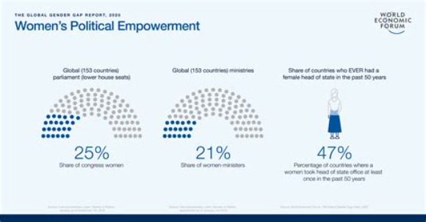
Empowering Women in the Workplace
Empowering women in the workplace involves creating a supportive and inclusive environment where women have equal opportunities for growth and leadership.
Companies can empower women by implementing fair hiring practices, offering leadership training, and promoting work-life balance.

Slide 9



Overcoming Gender Stereotypes and Biases
Breaking Stereotypes
Gender Equality
Inclusive Environment
Empowering women involves breaking stereotypes that limit their potential.
Promoting gender equality is essential for overcoming biases and discrimination.
Creating an inclusive environment helps mitigate the impact of biases on women.

Slide 10
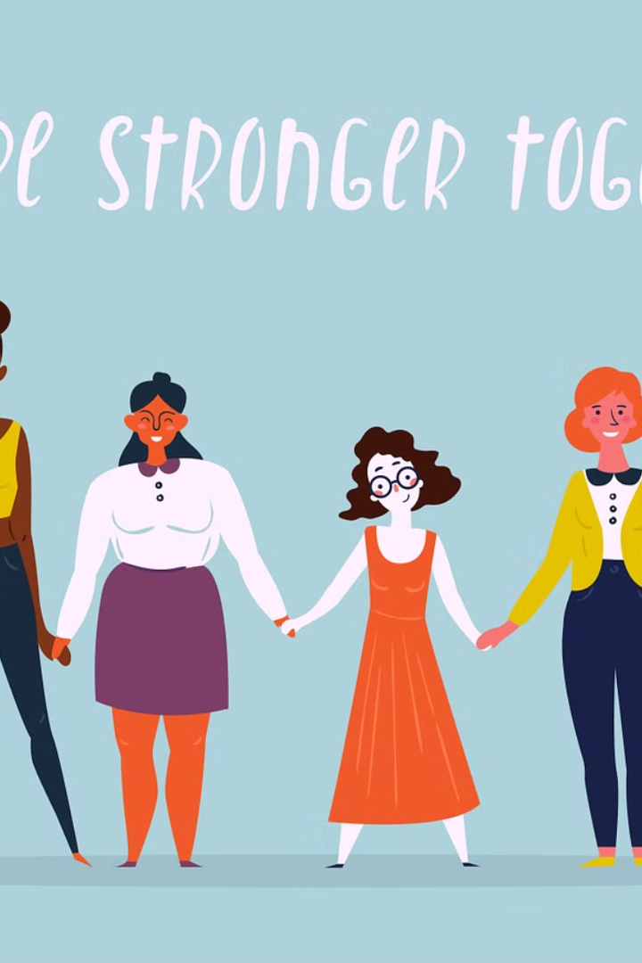
Supporting Women Empowerment Initiatives
It's time to take action in supporting women's empowerment initiatives. By advocating for gender equality in all aspects of life, we can create a more inclusive and equitable society.
Together, let's challenge stereotypes and promote opportunities for women to thrive, contributing to a better future for all.

Slide 11


